Slide 1
Advisory Report 2
Shrey Agrawal Jiayi Chen
David Dai
Hong Doan

Slide 2

Agenda
Business Understanding Revisit
Goals Statements
Reflections
Moving Forward

Slide 3
Business Understanding Revisit
“Build A Better Grinnell” is a community-based initiative aimed at improving the quality of life in Grinnell, Iowa.
The goal is gather data from the focus population (Grinnell residents), collect innovation from the base and have a shared understanding of strengths, visions, and priorities.

Slide 4
Goals Statements - What to Expect
Improve the word frequency analysis by
taking into account mis-spellings, plurals, adjectives, or nouns
counting multiple appearances of a word as one or weighted
Create groups of responses based on answers to questions of needs, strengths, frustrations
e.g. Cluster responses based on that criteria

Slide 5
Goal #1 Improve the word frequency analysis
Counting misspelled or plurals of words as the same word
NLTK Spell Checker & Word Lemmatizer
Identify common similar meaning phrases in responses
NLTK Word Lemmatizer
Identifying nouns and adjectives
NLTK Pos_Tag and Tokenize
Counting multiple occurrences of same word in a single response as 1
Ditching Weighing: Words occur at most 2-3
Making the “list” of words into a “set” of words

Slide 6
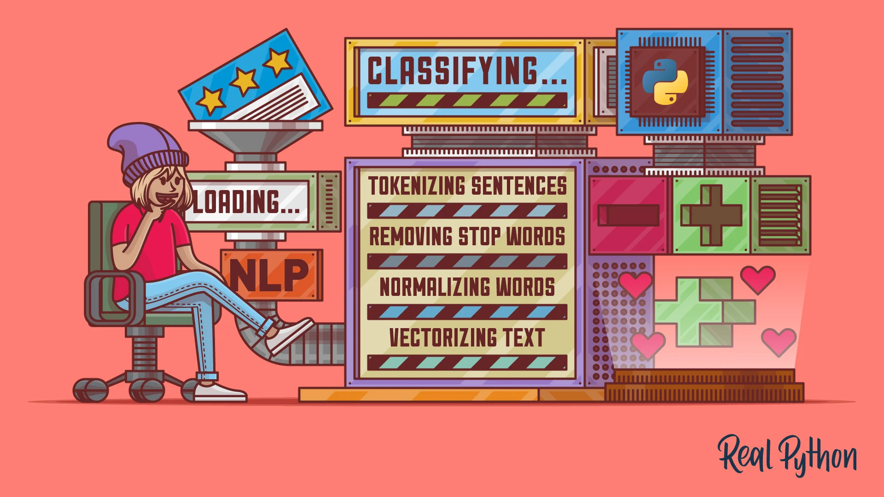
Tech Bubble for Goal #1: Word Count Part
Tokenizing
from collections import Counter
from nltk.tokenize import word_tokenize
From nltk.tag import pos_tag
NLTK Spell Checker
from nltk.corpus import stopwords, words
Word Lemmatizer
from nltk.stem import WordNetLemmatizer

Slide 7
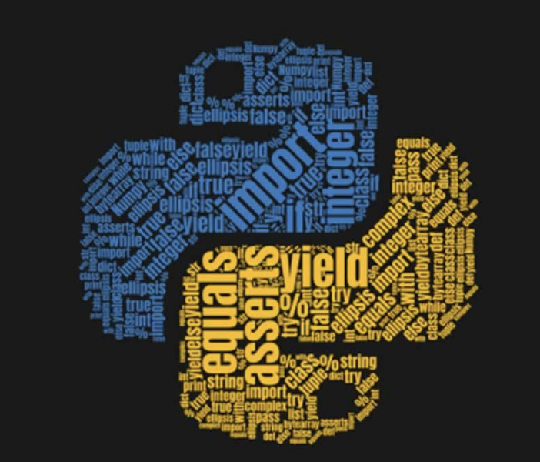
Tech Bubble for Goal #1: Viz Part
List v.s. Set in Python
Lists allow duplicates; Sets do not allow duplicates.
from collections import Counter
Visualization
from wordcloud import WordCloud
import matplotlib.pyplot as plt

Slide 8
Goal #1. WHAT CHANGED?
Q1: What are things that make you glad to live in Grinnell?
Q2: What things have the greatest positive impact on your quality of life in Grinnell?
Q8: What things have frustrated you about living in Grinnell?
Words | Before | After
Community | 141 | 134
Town | 95 | 97
Small | 89 | 84
Words | Before | After
Community | 74 | 74
Town | 60 | 62
Grinnell | 57 | 58
Words | Before | After
Lack | 149 | 117
Restaurant | 79 | 85
Community | 98 | 78

Slide 9
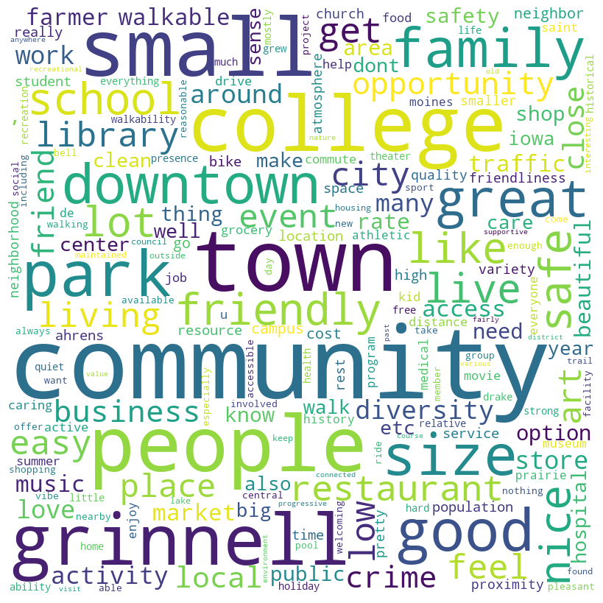
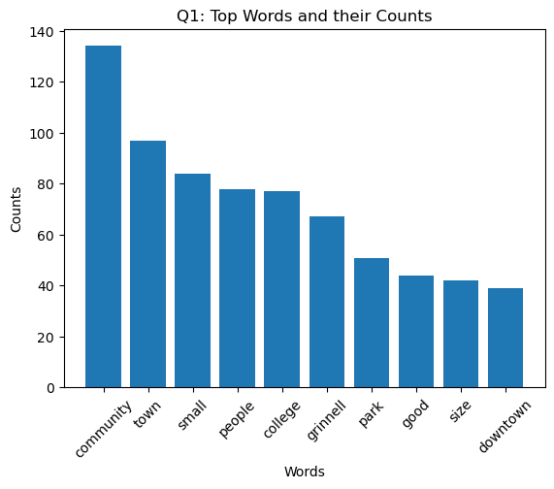
Q1: What are things that make you glad to live in Grinnell?

Slide 10
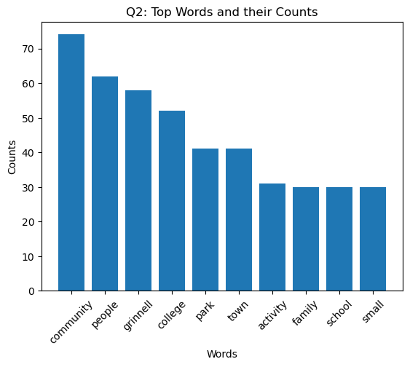
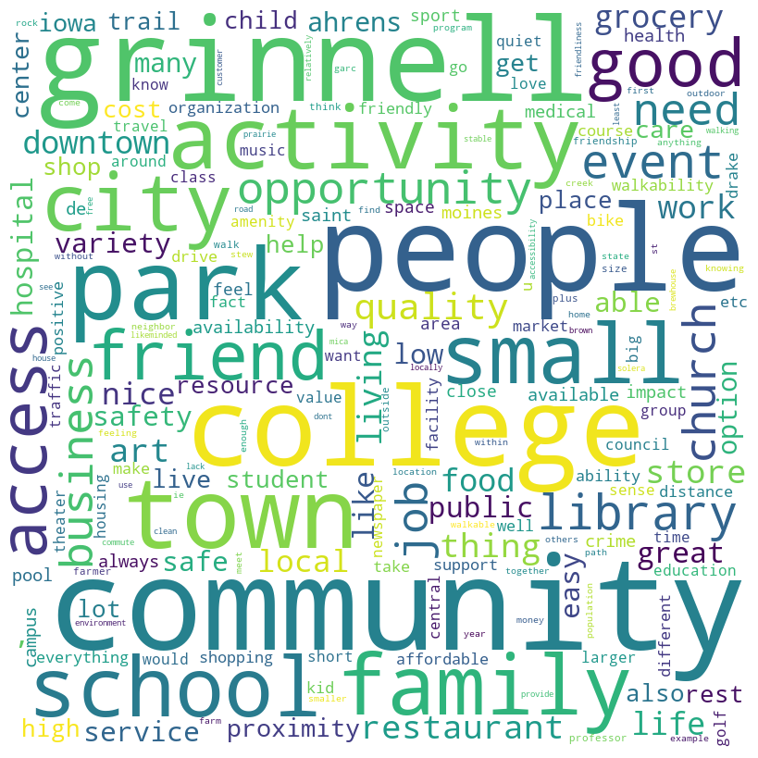
Q2: What things have the greatest positive impact on your quality of life in Grinnell?

Slide 11
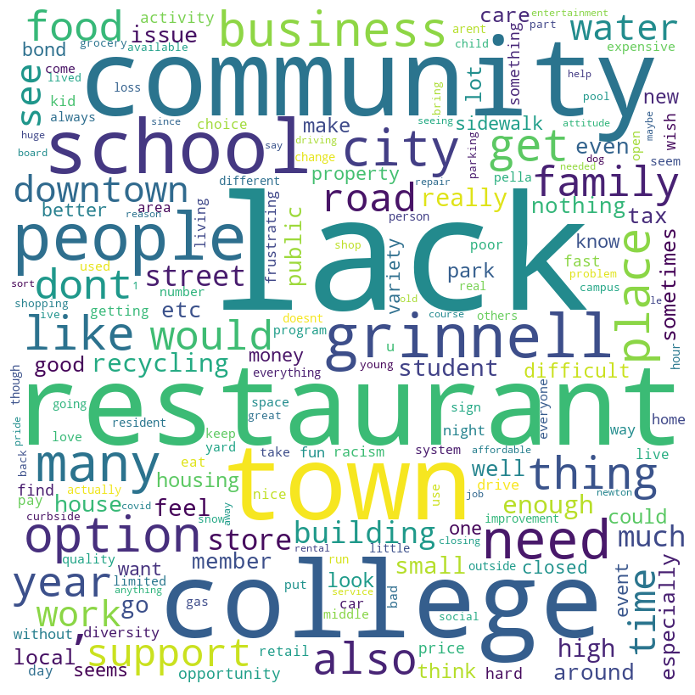
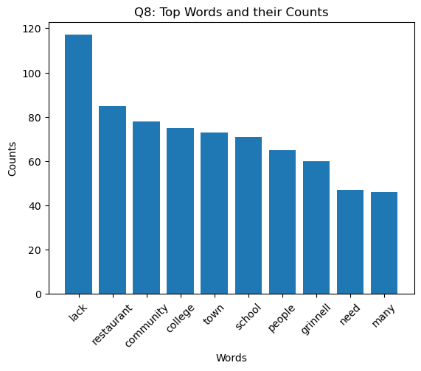
Q8: What things have frustrated you about living in Grinnell?

Slide 12
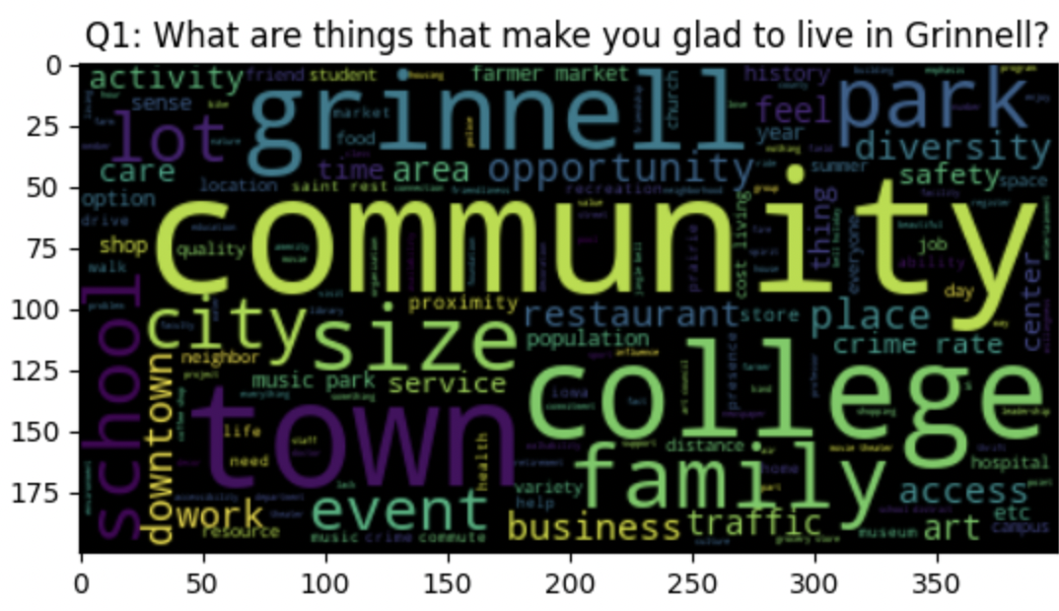
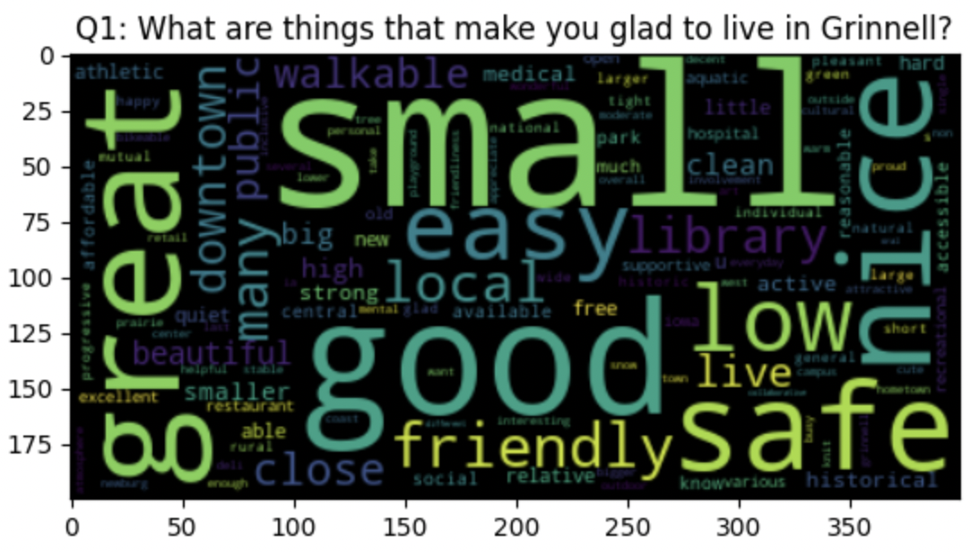
Nouns and Adjectives visualization

Slide 13
Goal#2 - Hierarchical Clustering
Vectorization
Converting text documents into numerical representations
Calculate cosine similarity
To use as distance metric between words in clustering
Clustering: K-Means and Hierarchical
K-means clustering: partitions data points into K clusters based on similarity in feature space and minimizes sum of squared distances to cluster centers.
Hierarchical clustering: groups data points into clusters in a tree-like structure based on pairwise similarity or dissimilarity, creating a hierarchy of nested clusters.
Visualizations

Slide 14
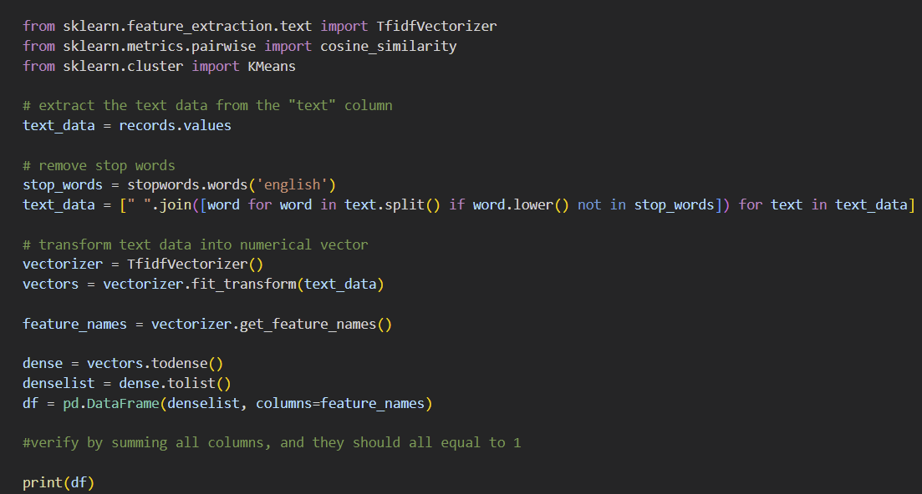
Tech Bubble for Step 1 - Vectorization

Slide 15
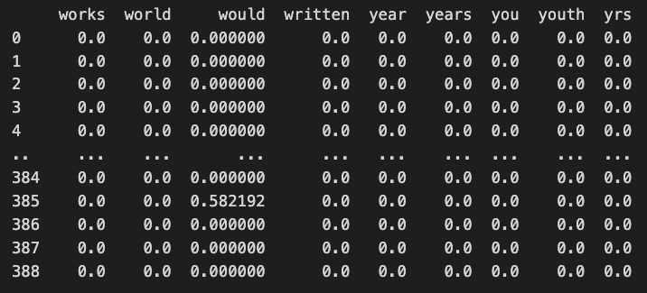
Step 1: Vectorization: converting text documents into numerical representations
[389 rows x 1196 columns]

Slide 16
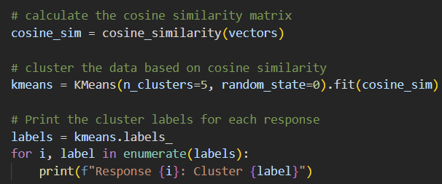
Tech Bubble for Step 2 - Cosine Similarity
Cosine similarity measures text similarity by calculating the dot product of two vectors and dividing it by the product of their magnitudes. The score ranges from -1 to 1, where 1 is identical, 0 is orthogonal (not similar), and -1 is diametrically opposed.

Slide 17
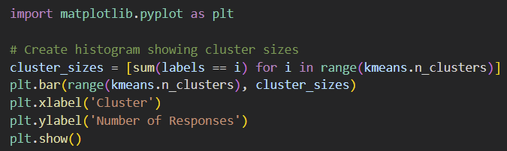
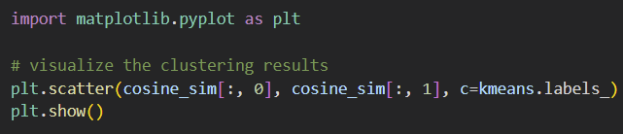
Tech Bubble for Step 3.1 - K-Mean Clustering
K-means clustering is a machine learning algorithm that groups similar data points together into a fixed number of clusters, based on their distance from each other, and assigns them a label to help identify them.

Slide 18
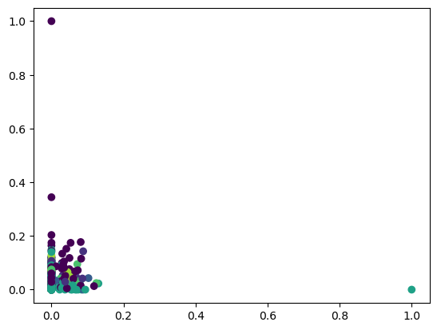
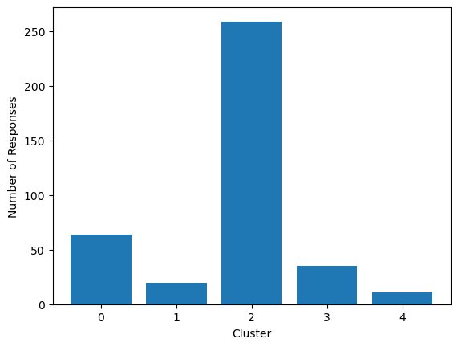
Step 3.1 - K-Mean Clustering

Slide 19
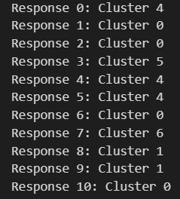
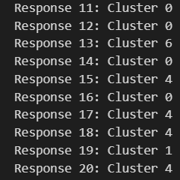
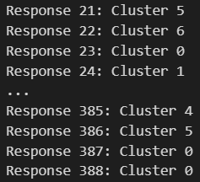
Step 3.1 - K Means Clustering - 7 clusters labels

Slide 20
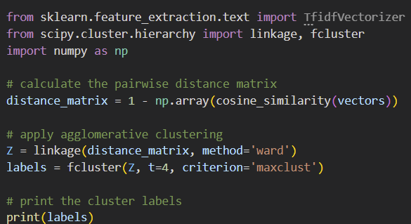
Tech Bubble for Step 3.2 - Hierarchical Clustering
Agglomerative hierarchical clustering starts with each data point as its own cluster and iteratively merges the two closest clusters based on some distance metric, such as Euclidean distance or cosine similarity. The process continues until all data points belong to a single cluster or a stopping criterion is met.

Slide 21
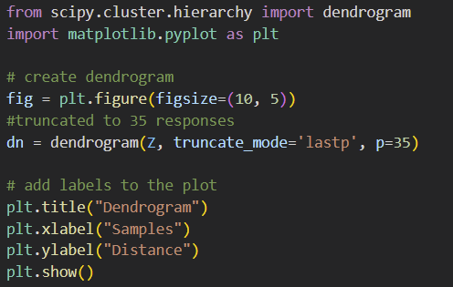
Tech Bubble for Step 4 - Hierarchical Clustering VIZ

Slide 22
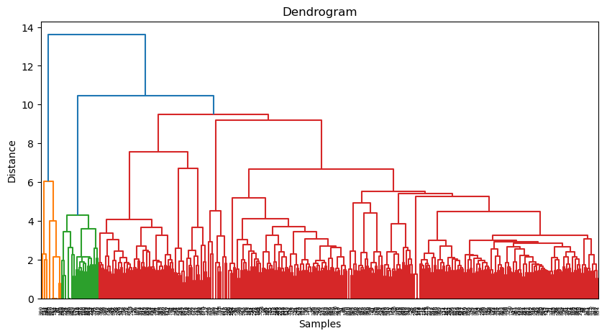
Step 3: Clustering: Hierarchical

Slide 23
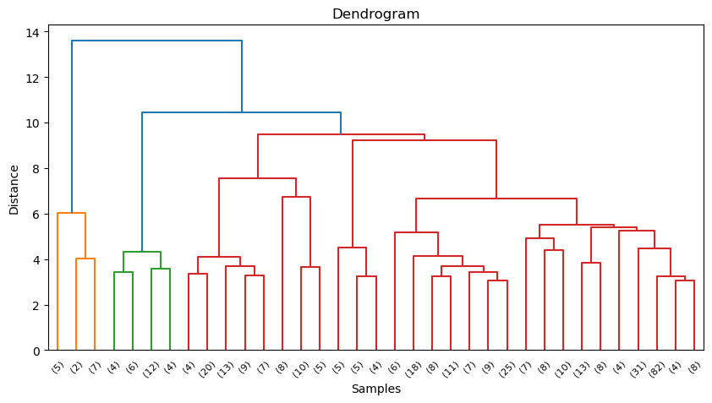
Step 3: Clustering: Hierarchical - truncated at 35 samples
height of each node represents the similarity or distance between the clusters being joined at that point.

Slide 24
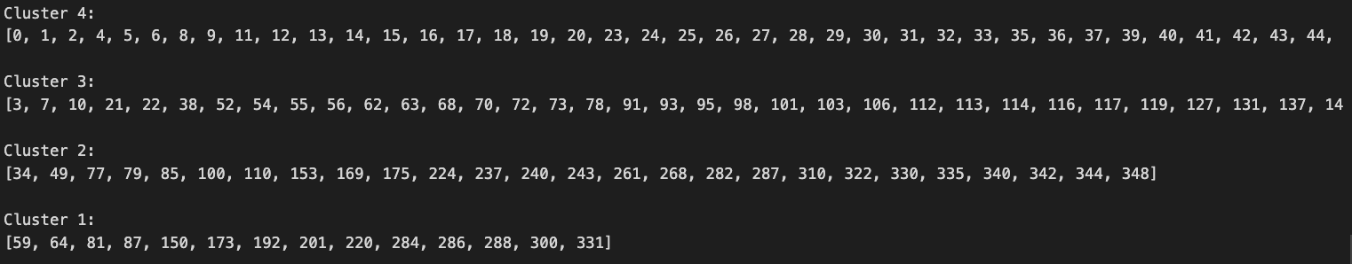
Step 3: Clustering: Hierarchical - cluster assigned to each response - 4 clusters
Snapshot of the output showing us which responses belong to which clusters
What do these clusters represent? Next step!

Slide 25

Reflections
Improve the word frequency analysis by
taking into account mis-spellings, plurals, adjectives, or nouns
counting multiple appearances of a word as one or weighted
Create groups of responses based on answers to questions of needs, strengths, frustrations
i.e. Cluster responses based on that criteria

Slide 26

Moving Forwards
Find Out What Each Cluster Mean
Success Criteria: Clusters should be interpretable based on underlying variables or concepts, and make sense in the context and goals of the analysis.
Data Cleaning for the Latest Version of the Dataset
Success Criteria: Incorporation of the new data into the old dataset; Applying the Analysis into the Final Version of the Dataset
Separate out nouns from adjectives
Combination or words (Phrases)
Success Criteria: Identify the phrases, such as Lack of XXX
NEXT NEXT STEP: Sentiment Analysis

